Slide 1


Prostate Cancer
Awareness
In association with

Slide 2
What is Prostate Cancer?

Slide 3
Prostate cancer affects 1 in 8 males
And 1 in 4 African – Caribbean men

Slide 4
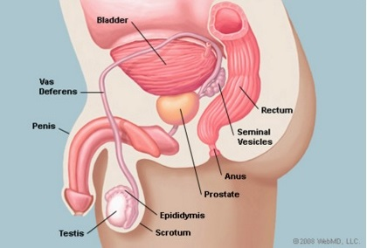
The Prostate

Slide 5
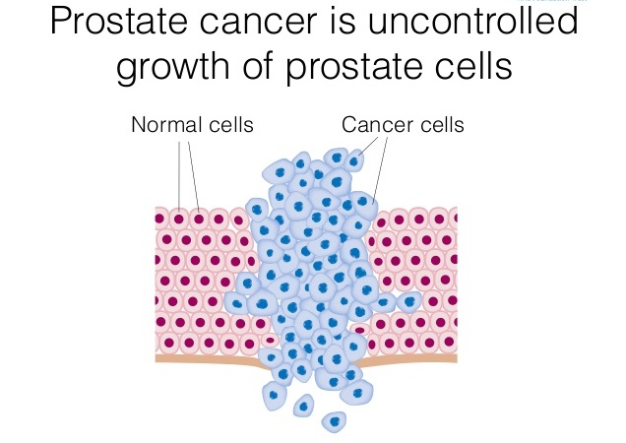
What is Prostate Cancer?

Slide 6
What are the risk factors?

Slide 7
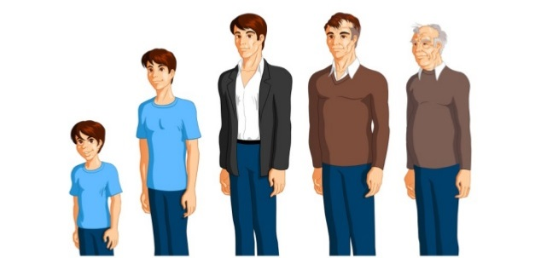
Age

Slide 8
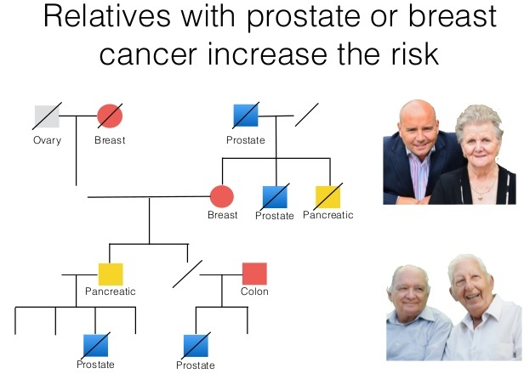
Family History

Slide 9

Ethnicity

Slide 10

Diet

Slide 11
What are the symptoms?
There are no symptoms of early prostate cancer
Trouble urinating, especially at night
The need to urinate more frequently
Burning sensation when urinating
Decreased force in the stream of flow
Blood in your urine
Bone pain, especially in pelvis or lower back

Slide 12
How do we test for it?
There are two tests:
PSA Blood test
DRE – Digital Rectal Exam

Slide 13
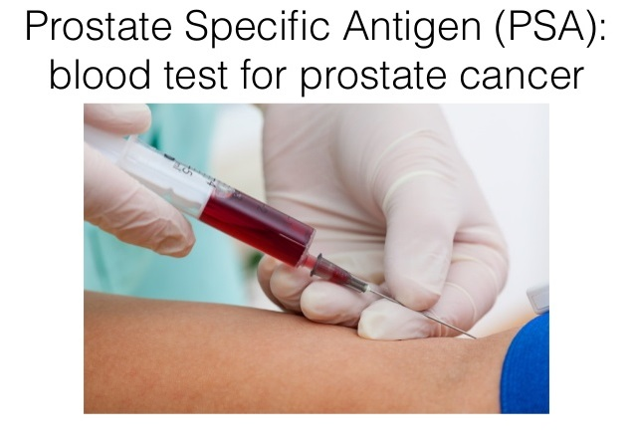
PSA Test -
Prostate Specific Antigen

Slide 14
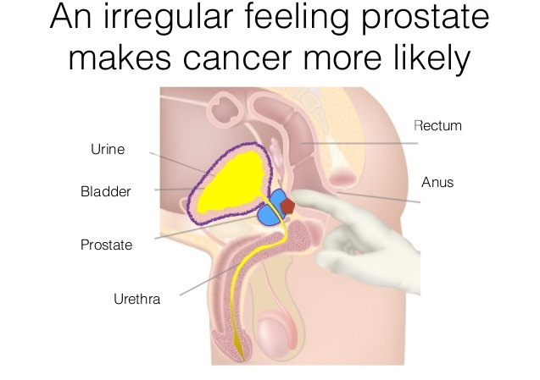
DRE –
Digital Rectal Exam

Slide 15
How do we treat it?
Surveillance
Surgery
Radiotherapy
Hormone Therapy
Chemotherapy

Slide 16
If caught early, prostate cancer is treatable
Get Checked Out
It could save your Life

